Slide 1
Sampling and types

Slide 2
Sampling
It is a statistical procedure that is concerned with the selection of the individual observation; it helps us to make statistical inferences about the population.
Samples are part of Population
Eg. To identify who be elected as city mayor , survey on the sampling should be done.
Sampling Bias : If every member of the population doesn't have equal like hood of being in the sample
Sampling Variability : Natural variation of sample is called as sampling variability. This is unavoidable and expected mostly in the case of random sampling.
Sampling Variability is acceptable, where not the Sampling Bias.

Slide 3
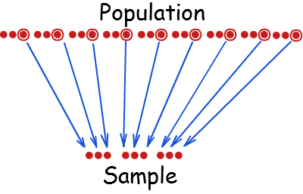
Sampling

Slide 4
Sampling Method
Types of Sampling
Probability Sampling
Non-Probability Sampling
Simple Random Sampling
Convenience Sampling
Stratified Random Sampling
Judgemental Sampling
Systematic Sampling
Quota Sampling
Cluster Sampling

Slide 5
Sampling Method
Types of Sampling
Probability Sampling
Non-Probability Sampling
Simple Random Sampling
Convenience Sampling
Stratified Random Sampling
Judgemental Sampling
Systematic Sampling
Quota Sampling
Cluster Sampling

Slide 6
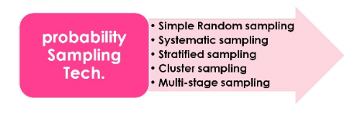
Probability Sampling
Probability sampling is a sampling technique wherein the samples are gathered in a process that gives all the individuals in the population equal chances of being selected.

Slide 7
Random Sampling
A random sample is one in which each member of the population has an equal probability of being chosen.
Eg. Every member of the population has an ID which is generated by computer. Member of the random ID’s are surveyed. Every member in the population will have equal probability.

Slide 8
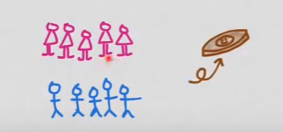
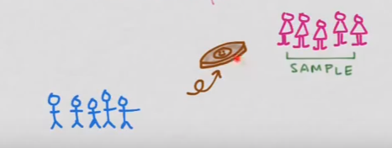
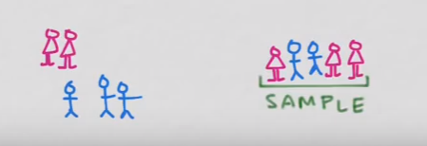
Simple Random Sampling
A Simple Random Sample is one in which each sample of a particular size n is selected such that every possible sample of a size n has the same probability of being chosen
Eg. Write the name of 5 boys and 5 girls and put it inside a hand and draw one.

Slide 9
Simple Random Sampling Cont..
Most widely used sampling method
Each sample of the chosen size has the same probability of the being selected
Every sample of size n has the same probability of being selected.
If there are N units in population, then all samples of size n have the same probability of 1/(^{N}C_{n}) of getting selected.
Procedure for SRS:
Prepare a unique list of N units of population – sampling frame.
Select n units from the list at random.
Sampling can be done with or without replacement. Sampling without replacement is more common

Slide 10
SRS Example
Example:
A bank wants to study customer perception of quality of its services to savings account holders. It is decided to go for a sample study. Say there are 1000 account holders and we want to select 50 a/c holders for the study.

Slide 11
SRS with Finite
Sampling from Finite Population:
A simple random sample of size n from a finite population of size N is a sample selected such that each possible sample of size n has the same probability of being selected.
Eg. Estimate the average IQ of university student where the total population (N) is 25,000. To do sampling , we will do a survey of on sample.
n is small – High Variance
n is high – Low variance
N is n – No variance
Eg.
# vehicles crossing the bride on a day
# Birth per year

Slide 12
SRS with Infinite Populations
Sometimes it is not possible to count the units contained in the population. Such a population is called infinite or uncountable eg.
# of stars in the sky
# germs in our hand
# people hitting all the railway stations in chennai

Slide 13
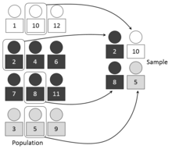
Stratified Random Sampling
Population is divided into a number of subgroups or strata.
In many situations the population may consists of groups of unit that are similar within the group and dissimilar across the groups.
You would like some meaningful representation from each group.
Stratified random sampling is appropriate when units are homogeneous within each stratum and heterogeneous across different strata.
The groups are called strata and stratified sampling involves using simple random sampling method to select sample units from each stratum.

Slide 14

Stratified Random Sampling
1

Slide 15
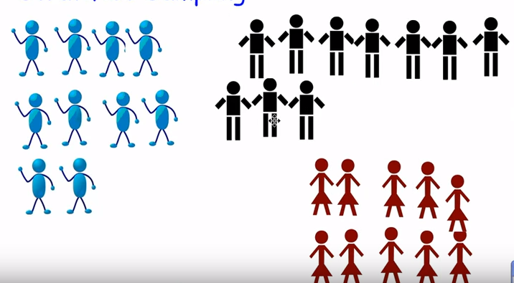
Stratified Random Sampling
1
2

Slide 16
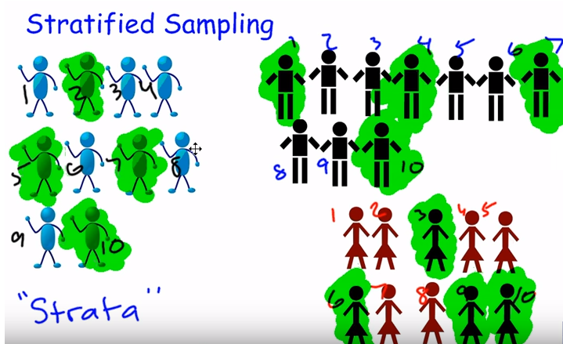
Stratified Random Sampling
1
2
3
n = 12
SRS on each strata

Slide 17
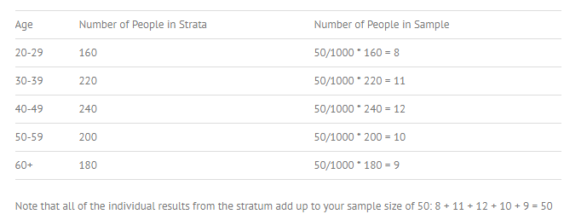
Stratified Sample Formula
Sample size of strata = (size of entire sample/population size)*layer size

Slide 18
Systematic Random Sampling
The units are picked up at regular intervals from the sampling frame after choosing the first unit randomly.
If there are N units in population and you require a sample of size n, then compute the interval k = N/n.
Every n th member of the population is selected to be the sample
Eg. Conduct a survey of students at college, pollster might contact every roll num of student 36 from each class
Example: A company wants to study job satisfaction level of its employees. A sample of 200 of 20000 employees is desired. Pick 50th row of the name starts with each alphabets.

Slide 19
Systematic Random Sampling - Example
Select 6th record from each columns
Telephone Directory
27089813 | 26787389 | 27673350 | 26689607 | 27273867 | 26869406 | 27202160 | 23273027 | 24509229 | 28077752
23280568 | 25757838 | 26578295 | 26540244 | 25910683 | 26120557 | 26691641 | 23224533 | 24823530 | 23617724
27062575 | 24606036 | 25722194 | 23709516 | 26037418 | 24137522 | 25750680 | 23343844 | 23244588 | 27838745
26156775 | 27537983 | 26090173 | 24644262 | 28014079 | 25993775 | 25024037 | 25713559 | 26445163 | 23342930
26463610 | 27966277 | 27273189 | 24943671 | 25520532 | 24013449 | 27110120 | 27527967 | 27476601 | 24099761
27106704 | 25864704 | 25325132 | 23350644 | 25753560 | 24353759 | 27828132 | 23324165 | 27403232 | 26405010
26994366 | 27213164 | 25852146 | 24618852 | 24085488 | 23867092 | 25211944 | 24461449 | 25950296 | 24142624
23963413 | 25935894 | 25136250 | 27996750 | 23299875 | 28093013 | 27755216 | 26020055 | 24184141 | 26986260
24872244 | 27192469 | 24507167 | 23725565 | 26133542 | 23960311 | 26777818 | 24503112 | 25225805 | 24949310
24664092 | 26831143 | 26184522 | 26185010 | 23276296 | 25625777 | 23471164 | 23510519 | 27952419 | 25814317
27501622 | 24304023 | 26387476 | 24004996 | 23981532 | 25316868 | 24880207 | 23843001 | 26762372 | 23838908
27251016 | 27692772 | 23544089 | 23926910 | 26122905 | 27441563 | 23909430 | 27727748 | 25355666 | 24425743
25222493 | 25006305 | 26183218 | 25784769 | 23895192 | 23770823 | 25306079 | 23393087 | 27958465 | 24096901
25149271 | 27045773 | 24699295 | 24074010 | 25740495 | 24750574 | 27389274 | 23596810 | 25799007 | 26812878
27814609 | 23530266 | 23225351 | 23202508 | 26829560 | 25944875 | 26949325 | 27278364 | 24973729 | 27385369
24149543 | 27808847 | 25015150 | 23163809 | 24375725 | 25501283 | 28033160 | 27728191 | 27844667 | 24278349
25292355 | 26401739 | 24448090 | 23460838 | 24710649 | 24777994 | 26800741 | 25861528 | 23650591 | 26296176
26543684 | 25593017 | 24305925 | 25854984 | 24830485 | 25479828 | 27519569 | 23672317 | 25376429 | 23950846
25472182 | 27482111 | 27423996 | 25114209 | 24537981 | 26986657 | 26573793 | 24155206 | 27947288 | 23743395
24380020 | 23936869 | 25233616 | 25943000 | 26496471 | 25911192 | 26692137 | 26196037 | 25381334 | 24608074

Slide 20
Cluster Sampling
When the population is scattered across wide geographic region and data collection is cumbersome one may prefer cluster sampling.
In many cases population is set in clusters
Students
Tourists
Lawyers
You have reason to believe units across the clusters are homogeneous
Cluster sampling method:
Identify clusters of population units.
Select a random sample of clusters,
Either select all the units of selected cluster or by SRS
If you perform a simple random sampling to select n/k units where k is number clusters, using simple random sampling or stratified random sampling, the procedure is called multistage sampling.

Slide 21

Clustered Sampling
1

Slide 22
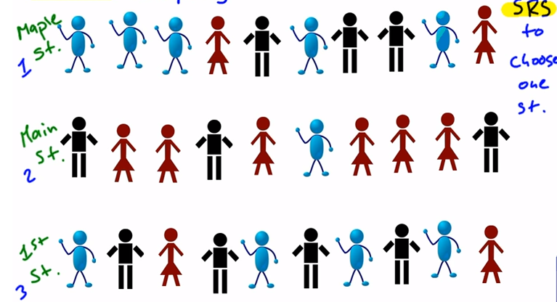
Clustered Sampling
1
2

Slide 23
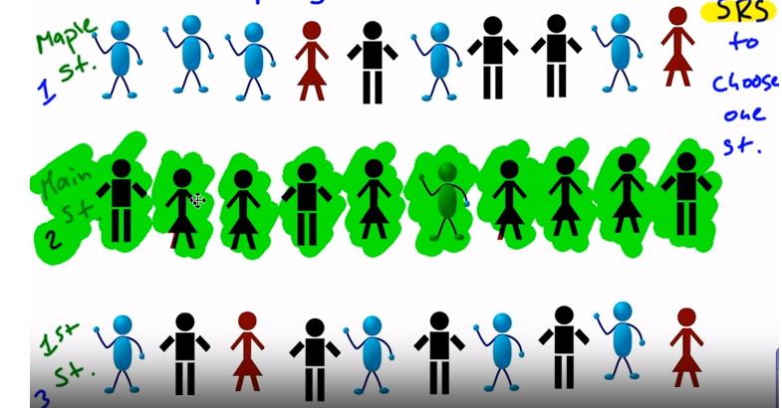
Clustered Sampling
1
2
3

Slide 24
Clustered Sampling
1
2
3
Instead of selected members for interview randomly based on members.
Selection is based on the cluster, in our case its street.
Main street 2 is selected using SRS and all the members will be interviewed

Slide 25
Non-Probability Sampling
In non-probability sampling, the selection of unit does not have a known probability of being selected.
The principles of probability are not applied to select the sample from the population.
It costs less time, effort and money to perform non-probability sampling.
Biases may creep in, making inferential statistics inaccurate.
The non-probability sampling methods are
Convenience Sampling
Quota sampling
Judgement sampling or expert opinion sampling

Slide 26
Non-Probability Sampling
CONVENIENCE SAMPLING
Samples are chosen by selecting whoever is convenient
Using available population units for study is called population sampling.
Using your institution’s sample units which are easily accessible
Using voluntary respondents to carry out surveys.
Secondary data collection methods are a sort of convenient sampling.
Eg. Pollster goes to the mall and take survey on 50 people whom he likes

Slide 27
Non-Probability Sampling
QUOTA SAMPLING
Allocating quotas for sample collection i.e. collect data about 100 girls and 100 boys. Giving quotas to volunteers to collect data.
Example For a survey, in a school, first students are divided into two groups - boys and girls. Then, from each group, the students are selected who have obtained marks more than 80%.

Slide 28
Non-Probability Sampling
JUDGEMENT SAMPLING
Using experts from the field of interest and gathering statistical information about the entity of interest. A more organized method is called Delphi method.
Example : A TV researcher wants a quick sample of opinions about a political announcement. They stop what seems like a reasonable cross-section of people in the street to get their views.

Slide 29
Thank You

